Slide 1
Considerations for LCLS-II HXR Undulator
Tor Raubenheimer
Based on studies by M. Rowen, H.D. Nuhn and Juhao Wu

Slide 2
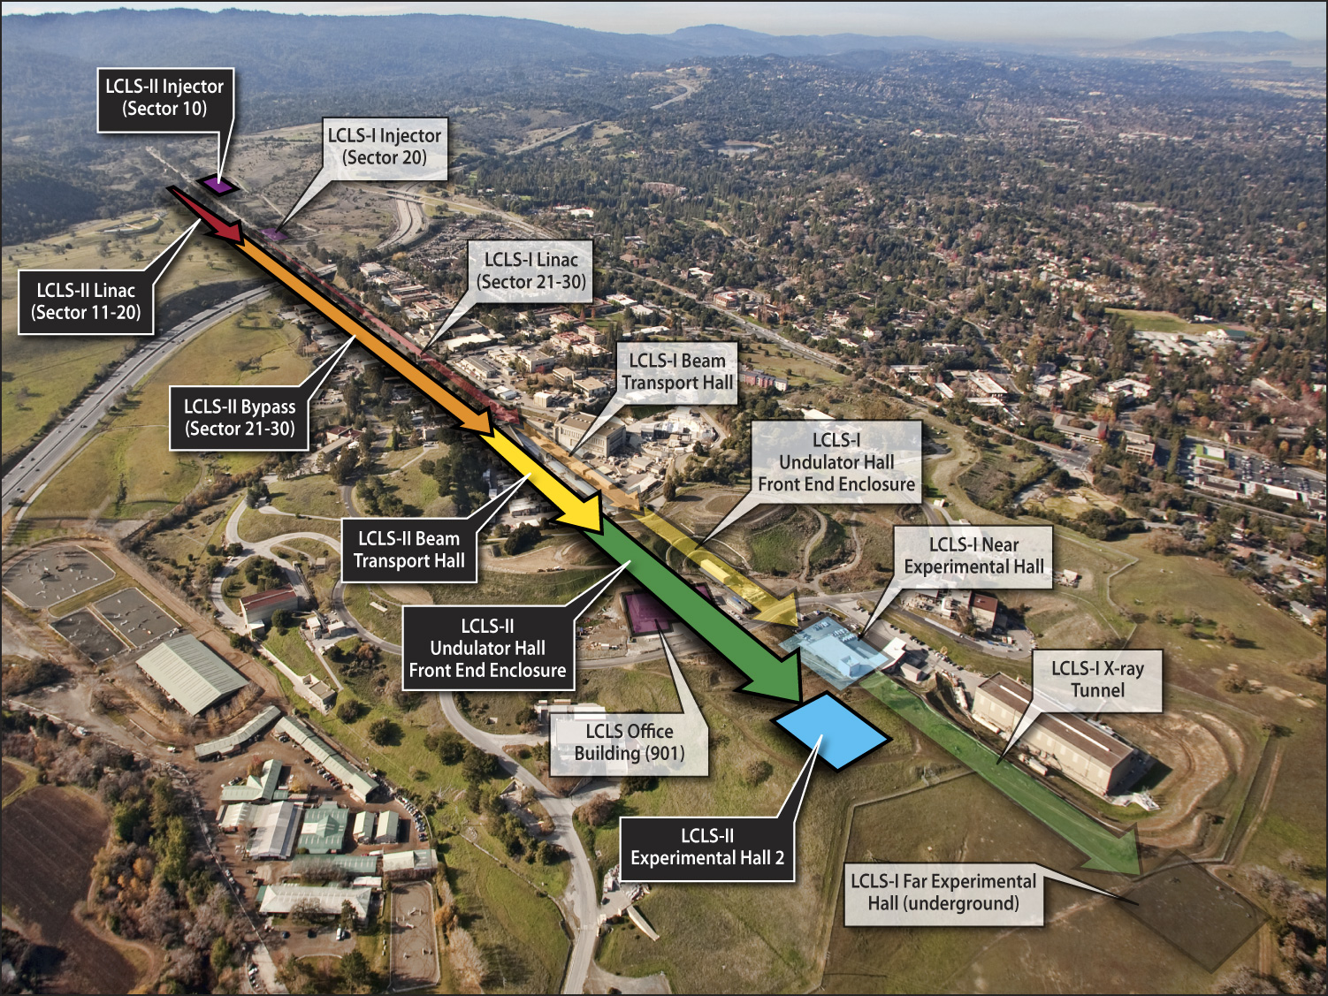

Slide 3
LCLS-II Accelerator Parameters
parameter | symbol | nominal | range | unit
Electron energy | E_{f} | 13.5 | 4.2 - 14 | GeV
Electron bunch charge | Q | 0.25 | 0.01 - 1.0 | nC
Pulse repetition rate | f | 120 | SS, 1 - 120 | Hz
Transverse slice emittance | γε_{x,y} | 0.6* | 0.1 - 1.2 | μm
Peak current | I_{pk} | 3.0 | 0.5 - 5.0 | kA
Slice energy spread | σ_{E} | 1.4 | 0.1 - 1.5 | MeV
Note that LCLS-I slice emittance is 0.4 μm at best (0.25 nC), but we design somewhat conservatively for a 0.6-μm level.
Making LCLS-II consistent with various extensions including multibunch options for two-bunch seeding and/or feeding multiple undulators per pulse

Slide 4
LCLS-II Accelerator for 250 pC, 120 Hz
6 MeV
σ_{z} ≈ 0.62 mm
σ_{δ} ≈ 0.05 %
135 MeV
σ_{z} ≈ 0.62 mm
σ_{δ} ≈ 0.07 %
250 MeV
σ_{z} ≈ 0.13 mm
σ_{δ} ≈ 1.1 %
4.2 GeV
σ_{z} ≈ 7 μm
σ_{δ} ≈ 0.43 %
13.5 GeV
σ_{z} ≈ 7 μm
σ_{δ} ≈ 0.01 %
Linac-X’
L ≈ 0.6 m
ϕ_{rf} ≈ −160°
V₀ ≈ −19 MV
Linac-0’
L ≈ 6 m
undulators
L ≈ 130 m
rf
gun
L0-a,b
Linac-1’
L ≈ 9 m
ϕ_{rf} ≈ −20°
Linac-2’
L ≈ 326 m
ϕ_{rf} ≈ −32°
Linac-3’
L ≈ 582 m
ϕ_{rf} ≈ 0°
LCLS-I
11-3b
14-4d
14-7b
20-4d
...existing
linac
11-1
b,c,d
LCLS-I
0.5-10 keV
X
BC1’
L ≈ 6.5 m
R₅₆≈ −46 mm
BC2’
L ≈ 23 m
R₅₆≈ −29 mm
2-13 keV
DL1’
L ≈12 m
R₅₆ ≈ 6.3 mm
HXR
1-km bypass line
SXR
0.25-2 keV
SLAC linac tunnel
BTH & U-Hall
Injector, linac, and compression parameters are all very similar to LCLS-I, but not exact

Slide 5
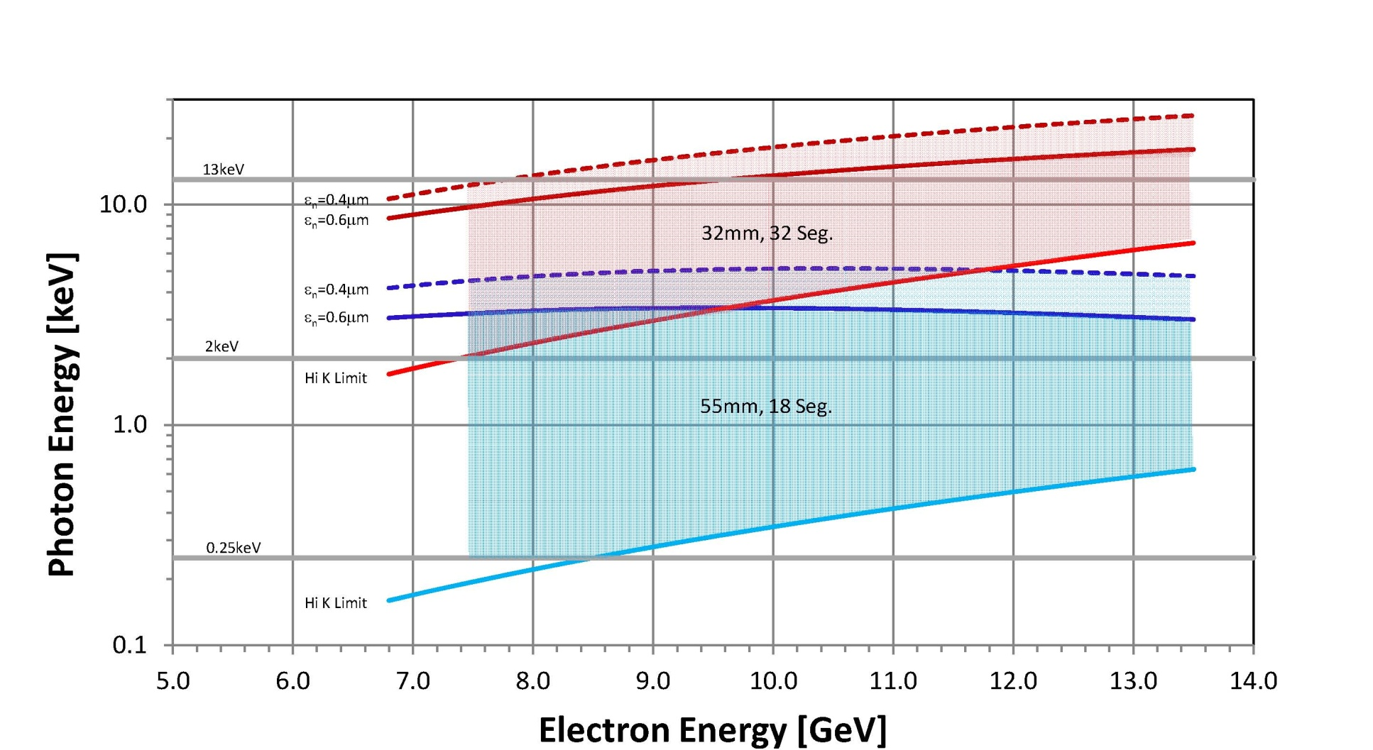
LCLS-II Spectral Range
SXU covers full .25 to 2 keV range at 8.5 GeV.
HXU just makes 13keV at 8.5GeV assuming 0.4mm emittance .
HXU at 7.3GeV to reach 2keV.

Slide 6
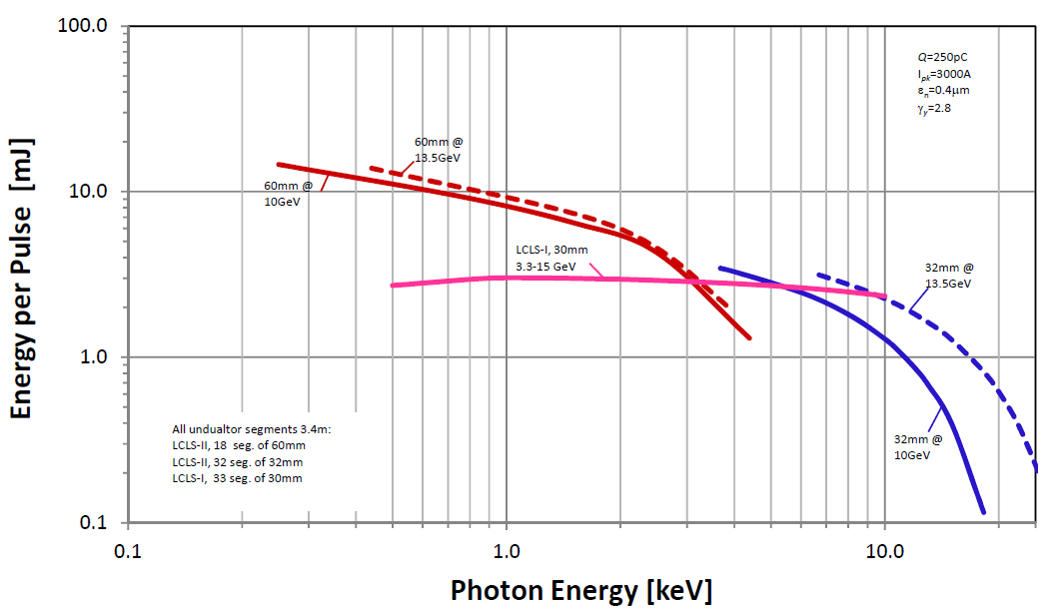
LCLS-II Operating Modes and Spectral Range
LCLS and LCLS-II can complement each other to broadly cover spectral range
Calculations by Michael Rowen
Note: baseline is 55 mm not 60 mm

Slide 7
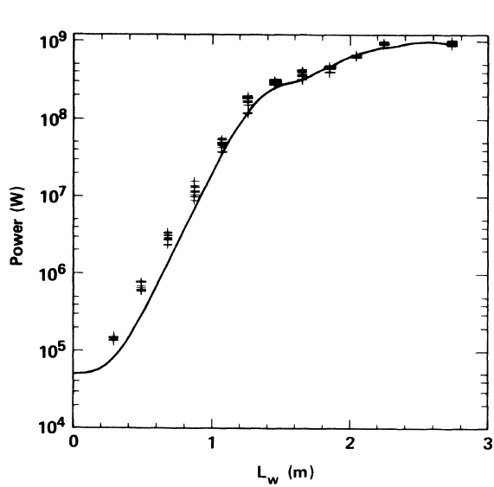
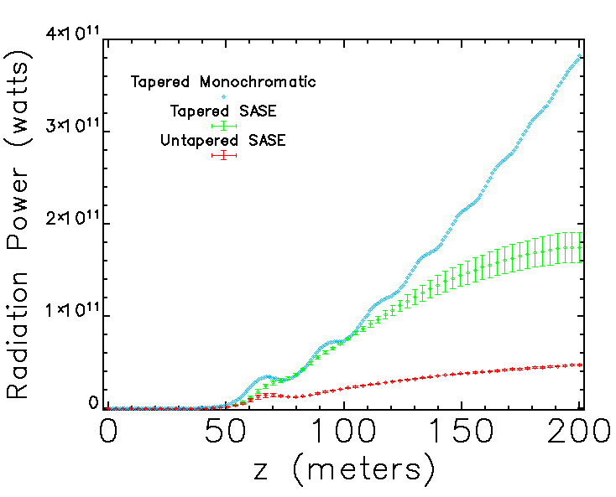
Seeding and TeraWatt Generation
Seeding concepts around for a while
New concepts for more compact systems (Geloni, et al.)
Strong desire for high peak power → single pulse imaging
Goal is >10 mJ in 10 fs → 1 TW
T. Orzechowski et al. PRL (1986)
W. Fawley, Z. Huang et al. NIMA (2002)
400 GW
Taper seeded
Taper SASE
Notaper SASE
LLNL microwave FEL

Slide 8
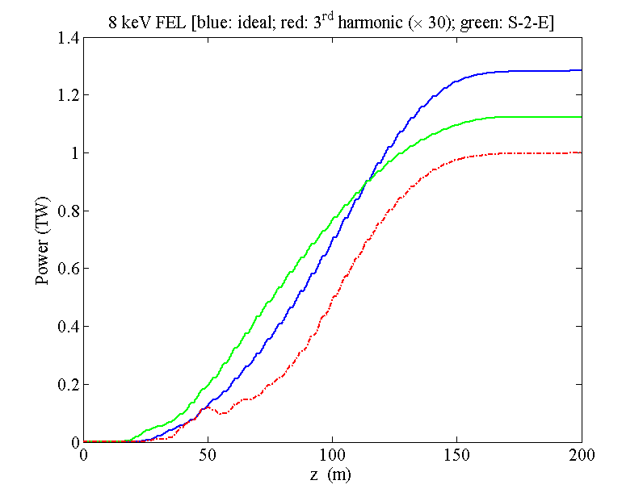
HXR TeraWatt Options for LCLS-II
Use seeding and heavily tapered undulator to increase power from 10’s GW → TW
Extensive study over last year
Focused on single bunch self-seeding option presently
LCLS-II simulation: 8 keV ideal bunch (blue) vs. start- to-end simulations (green) and 3rd harmonic (red)
Using 4kA, 10 fs, with self-seeding
Many % power in higher
harmonics
Undulator length after 31 meter self-seeding section

Slide 9
Initial HXR Simulations for a TW FEL
Study what undulator length is necessary for TW-FEL operating at: 8 keV, 13 keV and 18 keV
Studied seed power dependence ➔ 1 ~ 5 MW
Varied the seed undulator length from 9 to 11 undulators
Optimized TW taper for 3 different lengths (150, 200, and 250 meters)
Also looking at what could be done at start-up with ‘short’ undulator of 150 meters

Slide 10
Summary of Initial HXR Simulations
Simulations with 40 pC, ~4kA, 0.4 um at 13.5 GeV
Significant radiation power even at 18 keV
Baseline undulator hall was sized for ~190 meter HXR
Chose to extend undulator hall by 90 meters → space for 270 meter HXR undulator
FEL energy (keV) | SASE Undulator Length (m) | Saturation Full Length (m) | Power with 200 meter total undulator | Power with 250 meter total undulator | Power with 300 meter total undulator
8 | 39 | 215 | 1.05 | 1.13 | 1.14
13 | 43 | 270 | 0.77 | 1.28 | 1.37
18 | 48 | 330 | 0.48 | 0.73 | 0.92

Slide 11
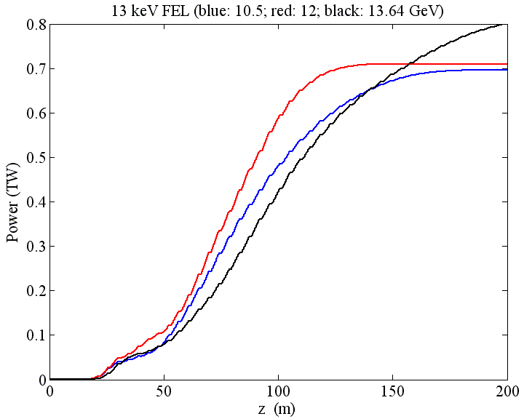
HXR Simulations for TW FEL @ LCLS-II
With S-2-E beam: energy dependence
Need to further work on the 12 GeV case
Remember 13 keV saturated after ~230m
at 13.5 GeV. This is ~160m at 10.5 GeV

Slide 12
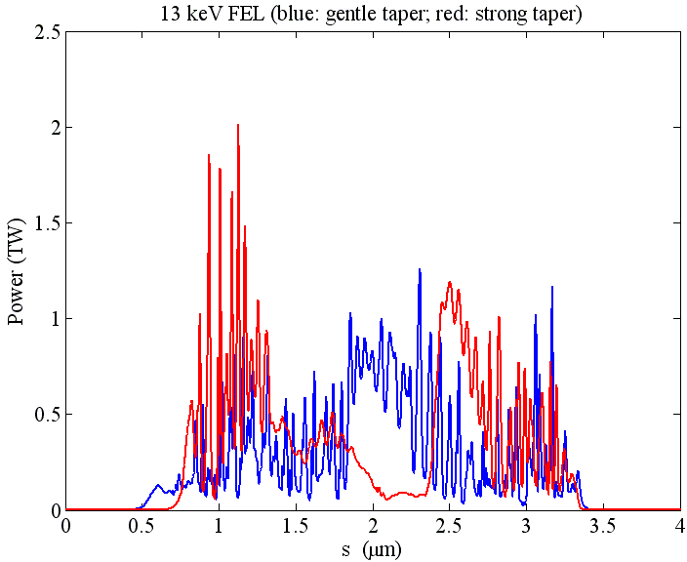
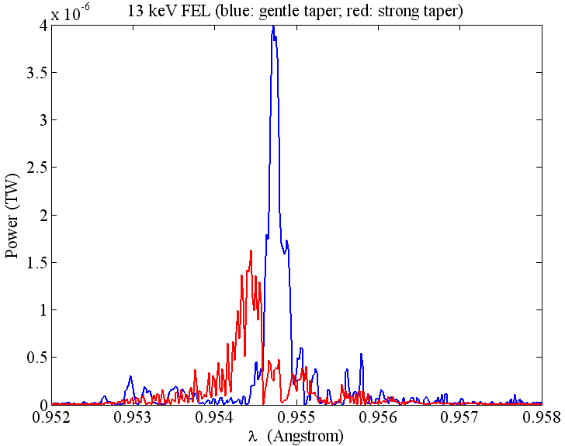
HXR Simulations for TW FEL @ LCLS-II
With S-2-E beam: tuning (in simulation) details

Slide 13
Summary
LCLS-II operating modes being defined
Multiple energy operating points with variable gap undulators
Working to incorporate TW capability into LCLS-II design (not as a baseline option but as a small upgrade)
Focused on single-bunch self-seeding right now but interested in two-bunch self-seeding for increased flexibility
Undulator Hall provided for 270 meter undulator (baseline undulator length is 120 meters) → TW-scale up to18 keV
Working to understand tolerance implications for self-seeded operation
Studying possibilities in SXR as well as HXR

